Slide 1
Movie Recommended System
Speaker
YIXIN HU
YUANKUN LI
JHU –2024.12.14

Slide 2
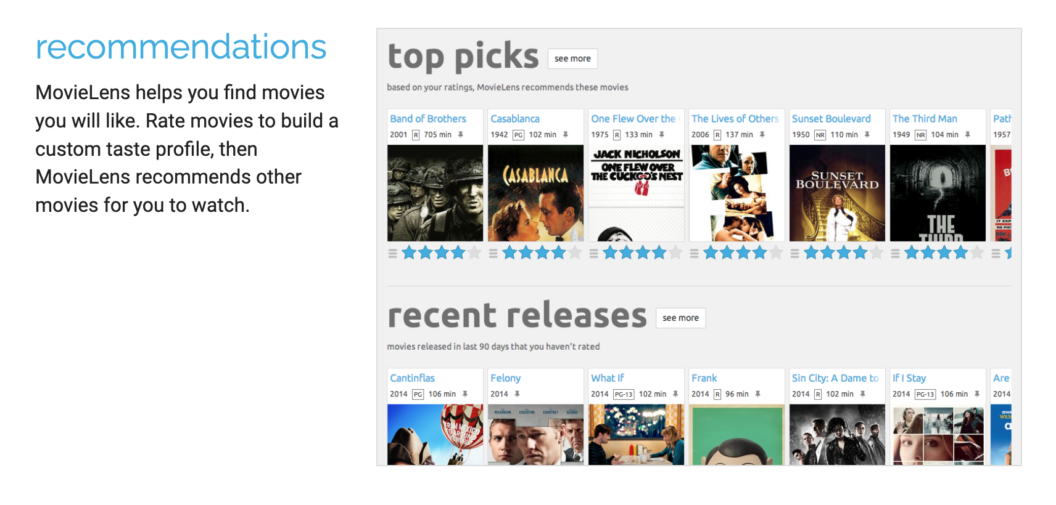
Introduction
A website which could recommend users movies they may like
2

Slide 3
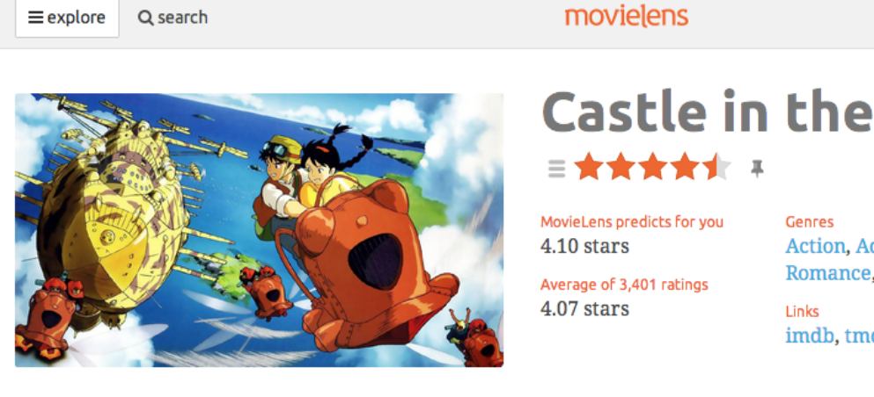
Methodology
Data Processing
Data Visualization
Collection
Processing
Recommended System
Feedback
System Training
GUI
Processing

Slide 4
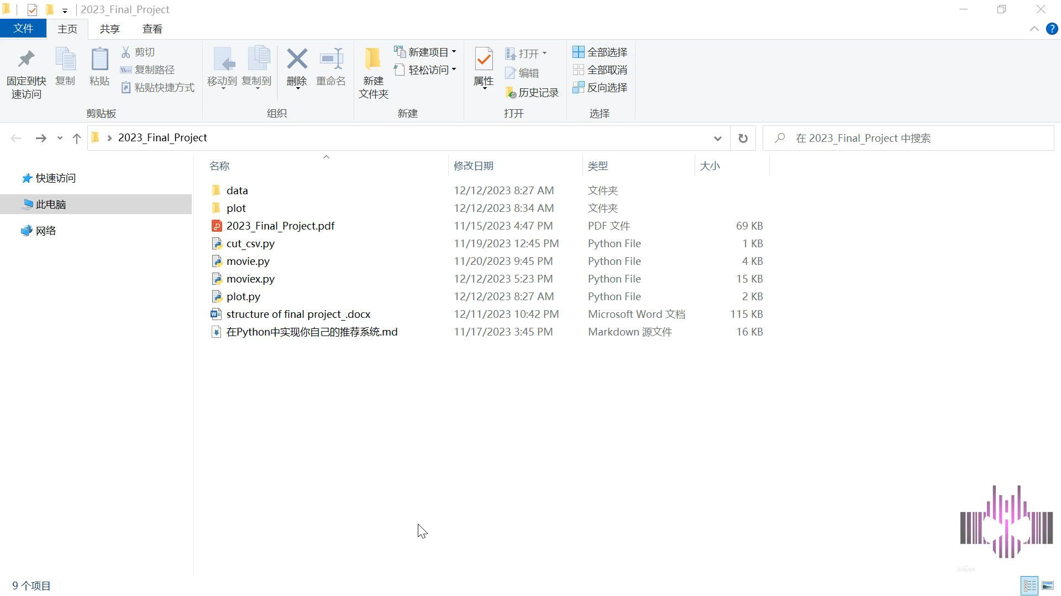

Slide 5


Future Work
Weaknesses：
limited function：No like or dislike option for users；Categorizing movies.
Limited data： We did not successfully retrieve data from the MovieLens website; instead, we downloaded some data from online sources and supplemented it with synthetic data.

